Slide 1

World Cup Fans System
Team: Jinlang He 001531339
Yuemei Chen 002954427
Ming Cheng 002925270

Slide 2


Table of contents
01
04
Introduction
Sequence Diagram
02
05
Model
contribution
03
06
Class Diagram
Run Demo

Slide 3


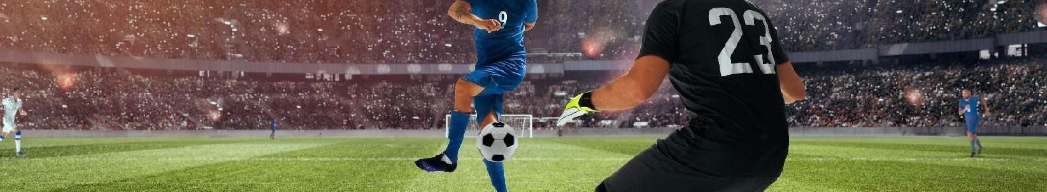
Introduction
The World Cup is driving fans all over the world into a frenzy. After all, only a small number of people can go to the scene to watch the game. Most fans will choose to go to the bar to watch the game, so we designed this system.

Slide 4

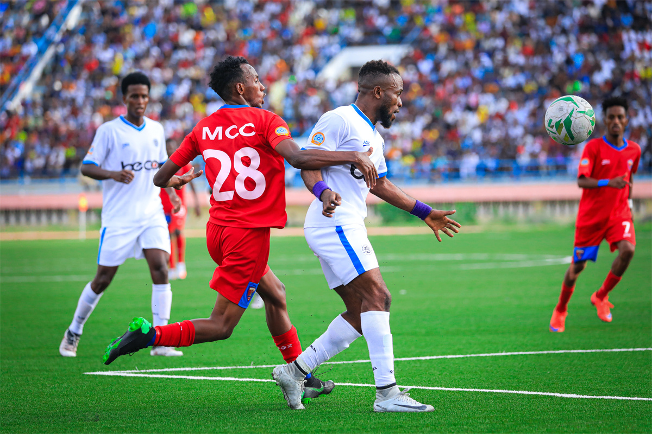

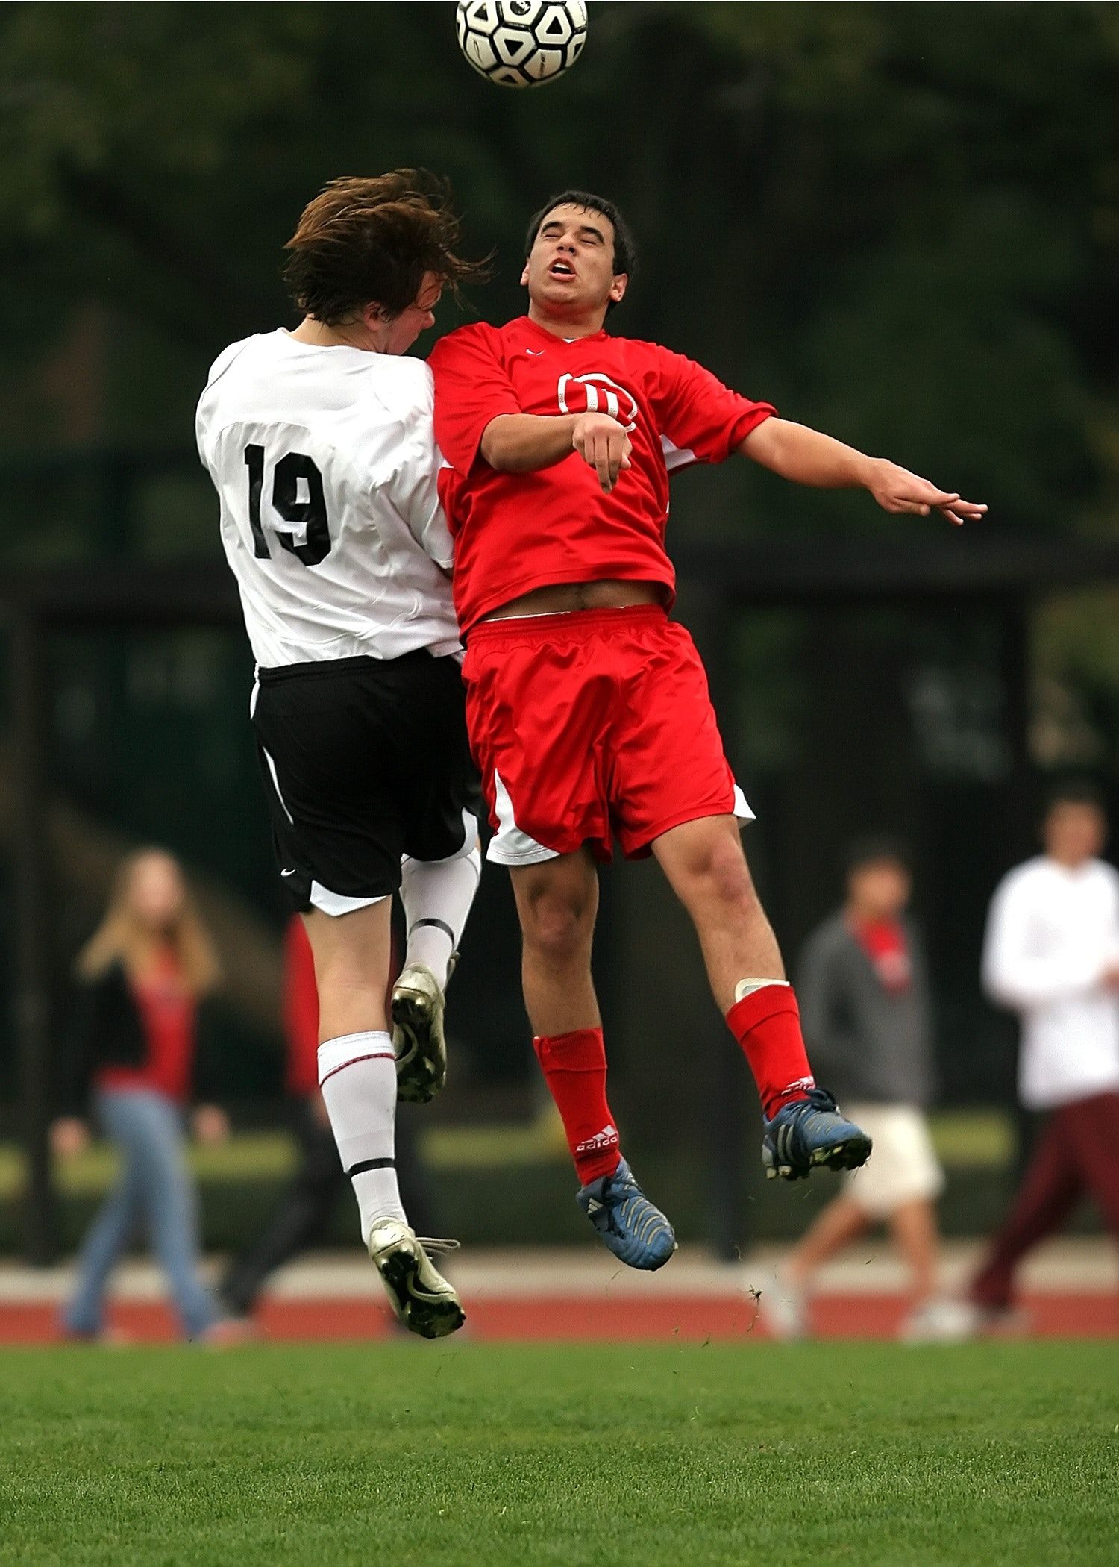
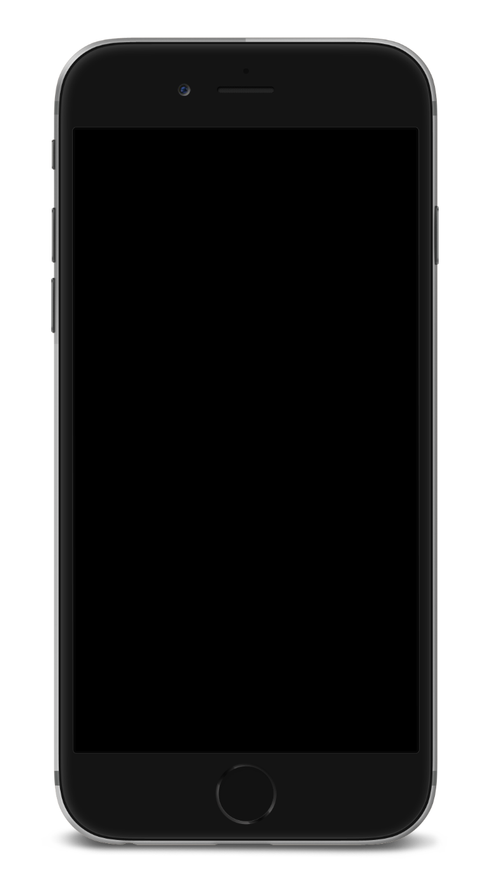
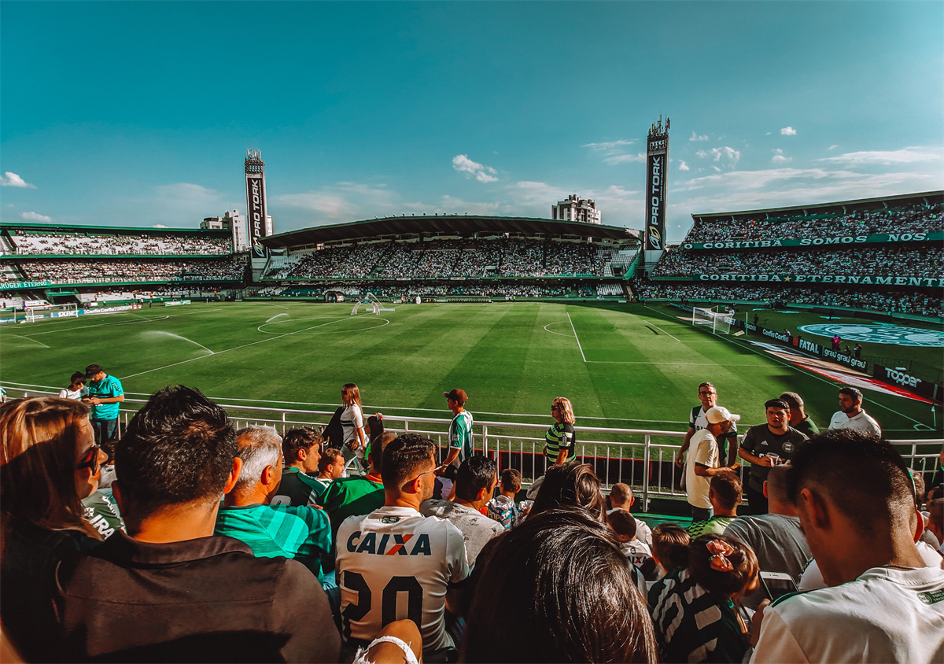
Our system consists of 4 Enterprises:
BarEnterprise
CheerAgency
WorldCupFansClub
Population

Slide 5
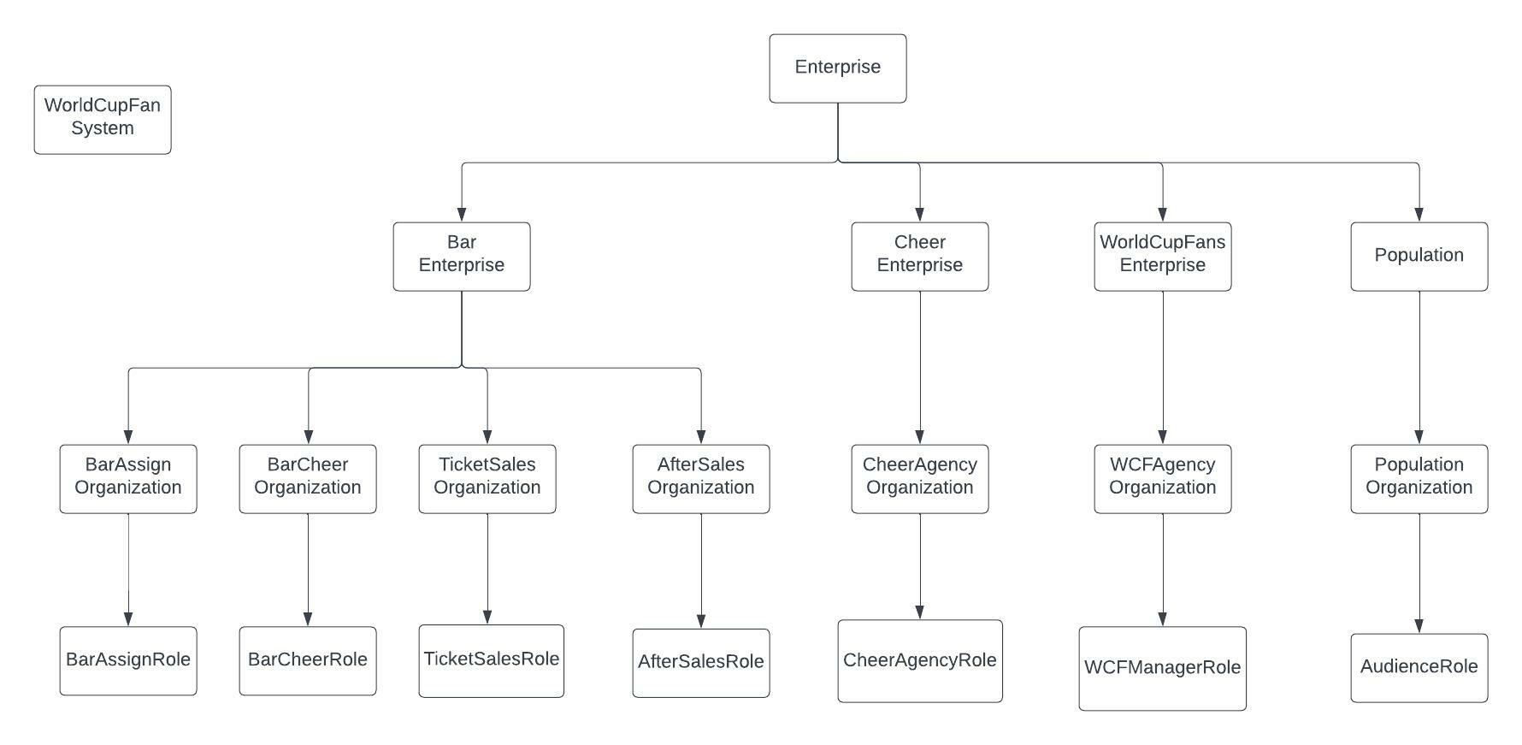
Model Explanation

Slide 6
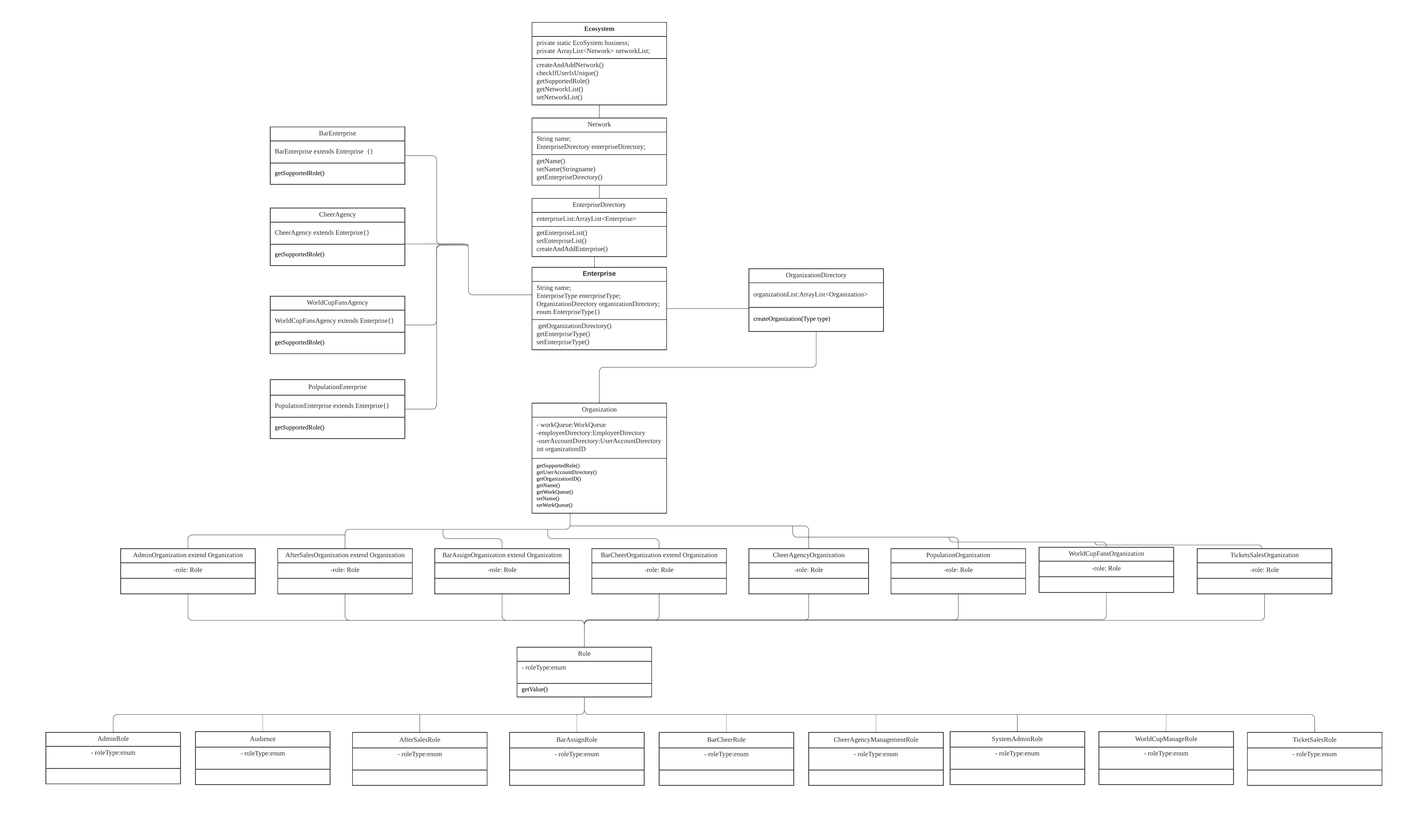
Class Diagram

Slide 7
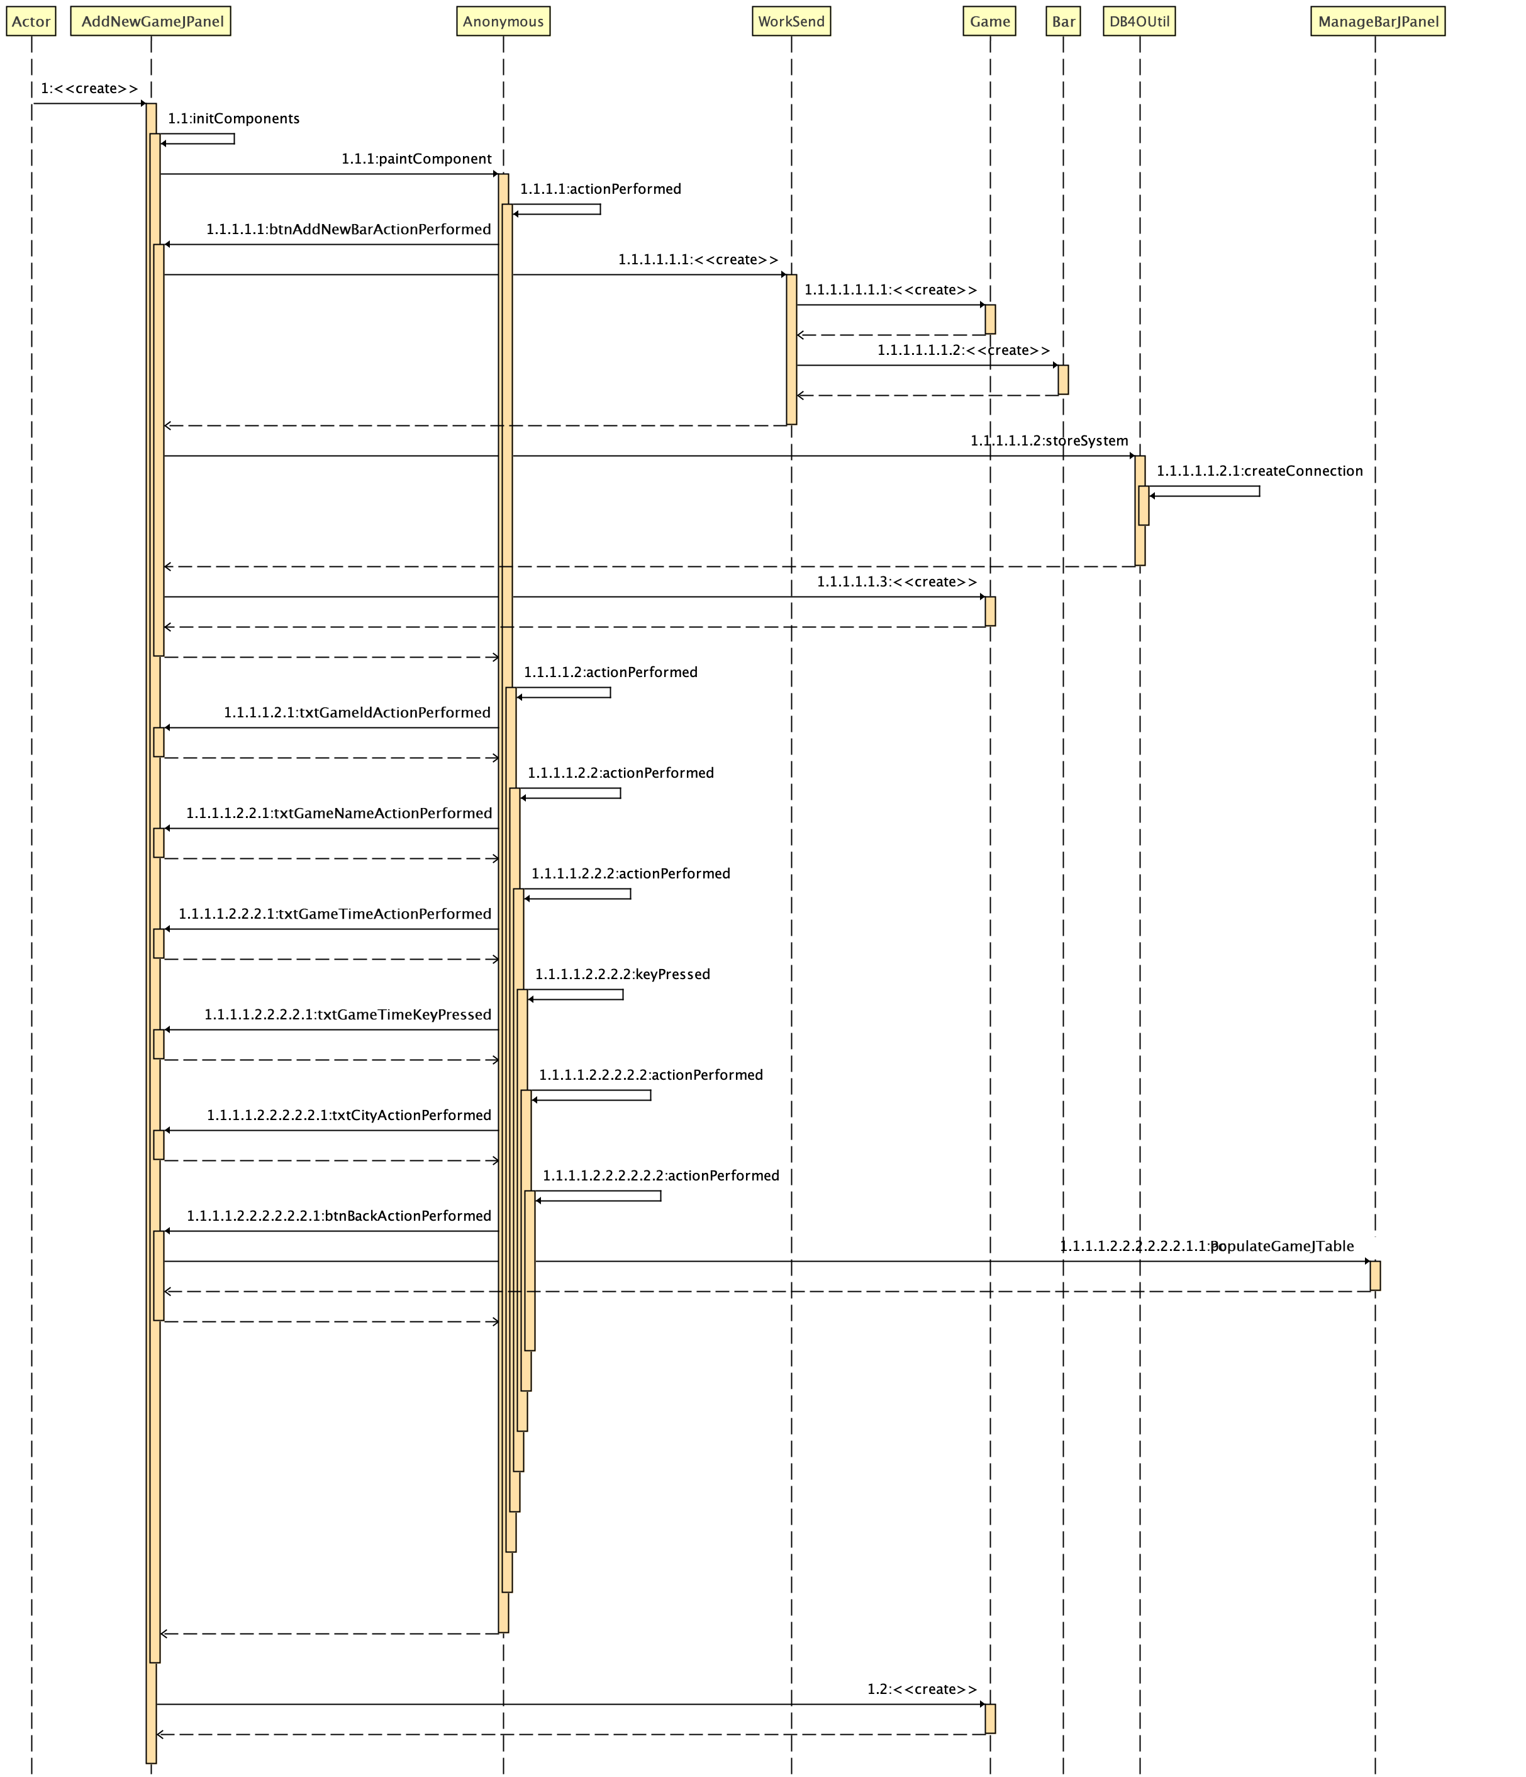
Sequence Diagram
Add New Game

Slide 8
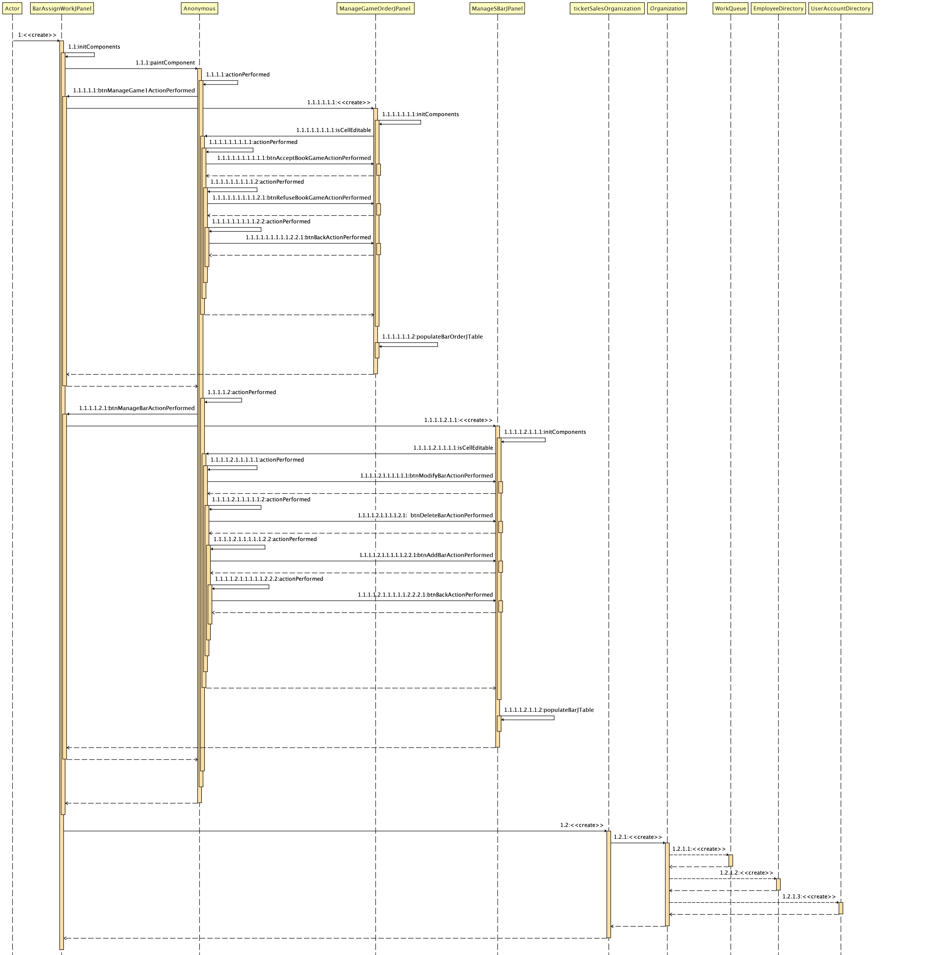
Sequence Diagram
BarAssignment

Slide 9
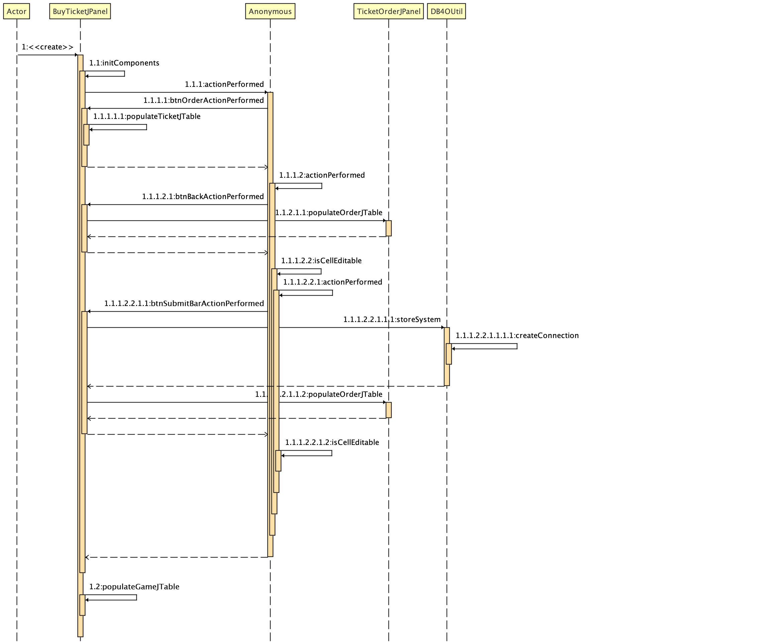
Sequence Diagram
BuyTicket

Slide 10

Contribution
Jinlang He:
Bar Enterprise,
BarAssignManagerRole,
TicketSaleRole&AfterSaleRole
Yuemei Chen:
SystemAdminstorRole, CheerAngencyEnterprise,
Ming Cheng:
WorldCupFansEnterprise,
WCFManager.

